Slide 1
Millimeter Wave Antennas

Slide 2
ANTENNA CHARACTERISTICS

Slide 3
ANTENNA CHARACTERISTICS
ANTENNA BEAMWIDTH
MAXIMUM POSSIBLE GAIN-TO-Q
POLARIZATION

Slide 4
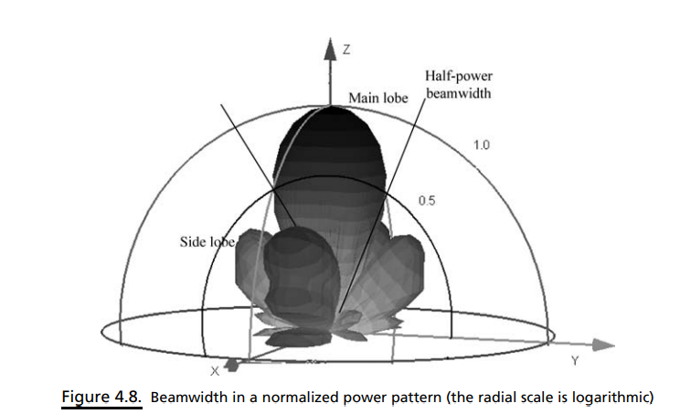
ANTENNA BEAMWIDTH
The radiation pattern of an antenna is essentially the Fourier transform (linear space to angle) of its aperture illumination function.
In a radiation pattern cut containing the direction of the maximum of a lobe, the angle between the two directions in which the radiation intensity (power) is one-half the maximum value is known as the half-power beamwidth (HPBW) (see Figure 4.8).
This is also commonly referred to as the 3-dB beamwidth
The beamwidth of an antenna is a measure of its directivity and is usually defined by the angles where the pattern drops to one-half of its peak value, which are known as the 3 dB points.

Slide 5
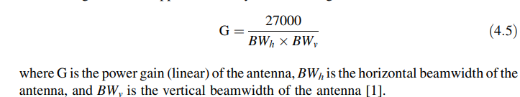
For a circular aperture antenna of diameter D, if the antenna is uniformly excited, this beam width is about 70 wavelength/D (the exact beamwidth actually depends on the aperture illumination function).
The next lobe in the pattern, usually called the first sidelobe, will be about 1/20 (13 dB less) of the value of the main lobe and any sidelobes that are further away will be of even lesser value.
The rate of decay of these sidelobes is an important parameter in many antenna applications and is used in many international standards as a defining parameter of antenna performance.
In general, the maximum gain can be approximated by the following formula:

Slide 6
MAXIMUM POSSIBLE GAIN-TO-Q
The quality factor Q of an antenna is an important overall parameter specifying the antenna performance and the inherent physical limitations of antenna size.
In particular, a high value of Q means that large amounts of reactive energy are stored in the near zone field. This in turn implies large currents, high ohmic losses, narrow bandwidth, and a large frequency sensitivity.
Knowledge of the antenna Q leads to a reasonably definite assessment of antenna performance because of its clearer physical implications.

Slide 7
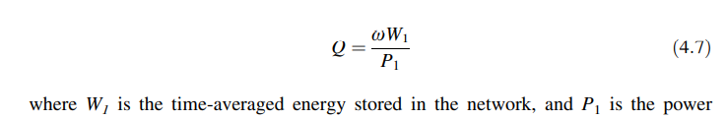
In millimeter wave applications, we need to maximize antenna gain and bandwidth (i.e., to minimize the quality factor Q for a lossless high Q antenna) simultaneously.
Therefore, it is important to optimize the gain-to-Q ratio in antenna design. It is clear that the optimization of the gain-to-Q ratio will yield a greater minimized Q than the minimum possible Q, since it demands that the gain be maximized at the same time.
The Q of an electrical network at resonant frequency v can be defined as

Slide 8
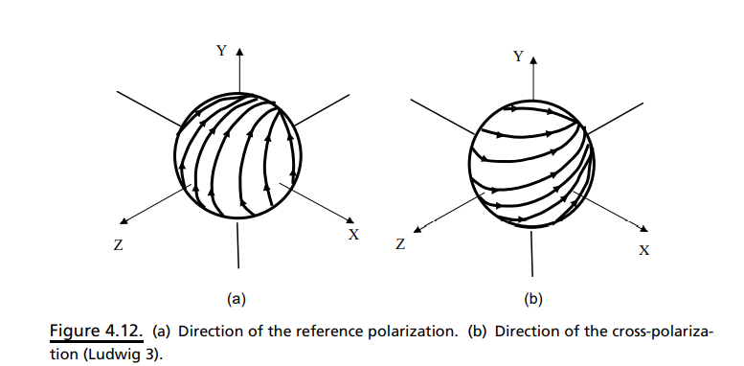
POLARIZATION
In free space, the energy radiated by any antenna is conveyed by a transverse electromagnetic wave that is comprised of electric and magnetic fields.
These fields are orthogonal to each another and also orthogonal to the direction of propagation.
The electric field of the electromagnetic wave is used to define the polarization plane of the wave and, therefore, describe the polarization state of the antenna
This wave is said to be linearly polarized, that is, the electric field vector is confined to a single plane.
Two independent linearly polarized waves at the same frequency can therefore exist and propagate along the same path.
This feature has been used for many decades in free space links, which utilize frequency re-use in order to double the capacity of a link for a given bandwidth. In this case, each polarization carries different information and is transmitted and received independently.

Slide 9
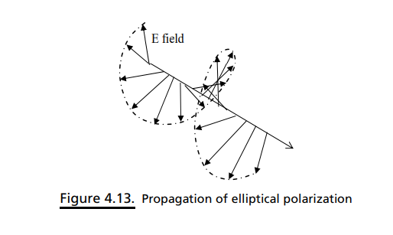
When the two polarizations carry the same information, and the two components possess a specific phase relationship with each other, we can construct a waveform in which the electric field vector rotates as the wave propagates.
If the relative phase of the two components is fixed at 90, and the amplitudes of the components are equal, the electric vector describes a circle as the wave propagates. Such a wave is said to be circularly polarized.
The sense or handedness of the circular polarization depends on the sense of the phase shift. In general, the two linear components of the propagating wave can have an arbitrary (though constant) phase relationship and also different amplitudes. Such waves are said to be elliptically polarized

Slide 10
Millimeter Wave Antennas
we present an overview of a millimeter wave antenna technology approach that offers the significant promise of enabling gigabit/per second wireless communication rates.
We will describe and discuss the requirements for the system components of a (nominally) 60 GHz free space point-to-point communications system.

Slide 11
Constraints in Antenna
The first constraint is that the 60 GHz channel is lossy (due to oxygen absorption), but is otherwise benign.
The excess loss at 60 GHz is approximately 15 dB/km, and we need to provide a means to overcome oxygen absorption and ensure that a sufficient margin exists to overcome other losses, such as rain-induced fading.
Here we can compensate by increasing the transmitter or receiver antenna gain. We can, for example, use a directional antenna gain to substitute for the raw transmitter power and receiver noise figure.

Slide 12
Constraints
The second constraint is that there is a strong multipath effect in an indoor environment. In other words, the line-of-sight (LOS) signal and the reflected signal will arrive at the receiver via different paths.
When the path difference is n λ/2 (n ¼ 1, 2, 3...), there is destructive interference between the signals and this causes a notch in the frequency spectrum.
The third constraint is that there is a space limit for portable devices, such as handsets. It is essential to know how much gain we can achieve for an antenna in such a limited space. T
Fourthly, we have the problem of noise and interference. The reliability of the communications link is defined by the signal-to-noise ratio (SNR). In a general sense, any undesired power appearing in the communications channel is noise and degrades the performance of the link. There are various sources of noise, which can be due to environmental radiators (either passive or active) or generated by equipment in the transceiver.
Finally, a wireless link can be interrupted by a blocking object (such as a human body), which introduces additional shadowing loss. To avoid this shadowing loss, a beam steering function or multibeam antennas can be considered to cope with the shadowing.

Slide 13
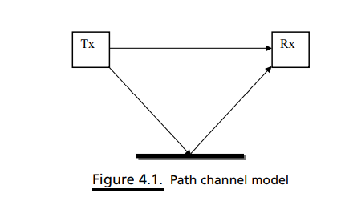
PATH LOSS AND ANTENNA DIRECTIVITY
For a wireless local area network (LAN), it is generally assumed that the signal arriving at the receiver consists of many copies of the information carrying signal, which have been generated by scattering and other environmental processes
Each path will have a specific delay, and arrival times will vary according to the dimensions of the environment.
For a specific path, as shown in Figure 4.1, the delay profile of the channel is determined by the delay time, path gain, and phase of each path.
In order to reduce the multipath effect, it is usual to receive each path and its corresponding time shift (and/or phase shift) in order to maximize the received power and reduce the signal distortion.
It is usually necessary to reduce the effects of the major paths, which have the most power

Slide 14
Solution
To combat these effects, we need to focus or direct the radiated power from the antennas in a given direction.
The power flux density in that direction will be greater than if an omnidirectional antenna were used to transmit the same power (the power presented at the antenna input terminals), and the ratio between these values (that is, the degree to which the antennas enhance the power flux density relative to an isotropic radiator) is called the antenna gain.
On the other hand, the degree to which the power is confined is called the directivity (or how directional the antenna is).
These two quantities are closely related by the radiation efficiency of the antenna and can be expressed as follows:
Gain =efficiency x directivity

Slide 15
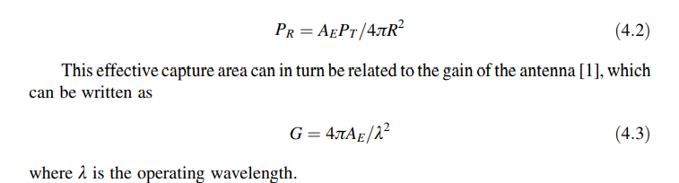
A typical antenna is able to couple energy to and from free space with an efficiency of approximately 65%
The usual approach to establishing the power received by an antenna is to consider an isotropic radiator transmission power PT so that this power is distributed over the surface of an expanding sphere as the wave propagates
Power is distributed over the surface of an expanding sphere as the wave propagates. At the receiver, the power flux density (power per unit area) is then PT/4piR² , where R is the distance between the transmitting and receiving antennas.
The received power is then determined by the effective capture area AE of the receiving antenna, so that the power received is

Slide 16
Antenna Types

Slide 17
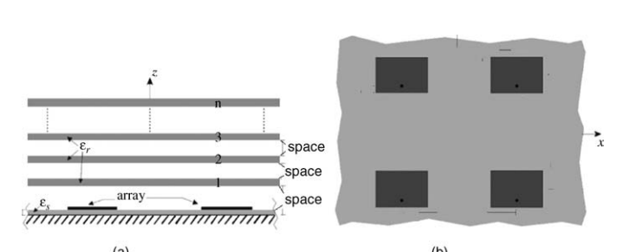
Fabry-Perot cavity (FPC) Antenna
It could be excited by a single source located inside the cavity, such as a coaxial probe, a microstrip patch, a slot in the ground plane, or a waveguide horn
It hosts a dual-polarized array with sparse elements

Slide 18
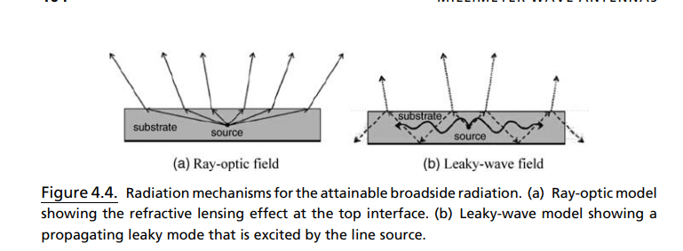
Ray optic and Leaky wave model
It was shown that a highly directive beam in this class of antennas is also produced by an excited leaky wave with a small attenuation constant and large phase velocity.
The leaky wave model of was compared with a ray-optic description, as illustrated in Figure 4.4

Slide 19
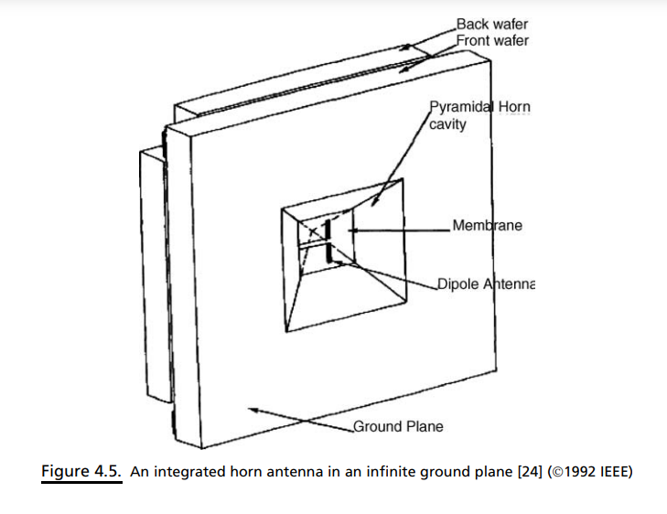
High directive and High gain Antenna
One of the methods of achieving such high directivity and gain in a small size involves combining a planar antenna with a three-dimensional antenna.
Combination 1:
A dipole antenna can be combined with a horn antenna, as illustrated in Figure 4.5.
Similarly, a patch-fed horn antenna has been experimentally investigated at microwave and millimeter wave frequencies.
The results indicated that for a 70 deg flare-angle horn, horn apertures from 1.0 λ -square to 1.5 λ -square, with dipole positions between 0.36 and 0.55 λ, yield good radiation patterns with a gain of 10–13 dB at 60 GHz, and a cross-polarization level lower than 20 dB on boresight

Slide 20
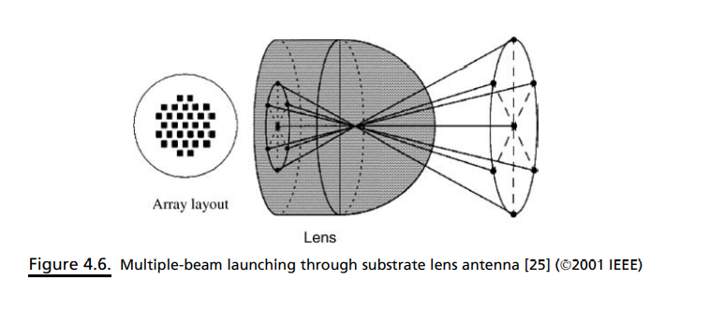
Combination 2:
Figure 4.6 shows that a lens fed by multiple slots can radiate multiple beams with a minimum 3-dB level of overlap between adjacent beams.
The coverage of the lens antenna system has been optimized through the utilization of a multiple-slot arrangement, leading to a broad scan coverage.
The multiple-beam lens antenna is suitable for an indoor wireless access point or for use as a switched-beam smart antenna in a portable device.

Slide 21
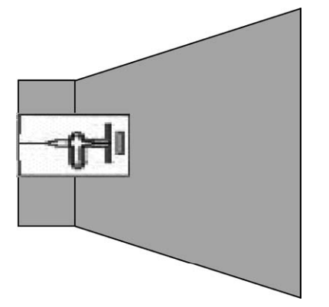
Combination 3:
It is also possible to excite a circular horn antenna with a quasi-Yagi antenna, as illustrated in Figure 4.7 .
Single-mode operation is achieved by placing the circular waveguide transition in the horn, which suppresses the potential excitation of higher order modes. For a single-mode circular horn antenna, a typical aperture efficiency of 60% at 60 GHz can be achieved due to the high radiation efficiency of the quasi-Yagi antenna.
The measured antenna gain and radiation patterns of the longer horn correspond to optimum horn characteristics with a waveguide input. Wider bandwidth can be achieved by doing the transition in the waveguide that feeds the horn.
The integration of a quasi-Yagi antenna with a horn makes this antenna a symmetric two-port device, regardless of the angle of reception, which can be realized inbalanced receivers and transmitters.
The edge diffraction from the incoming horn aperture is reduced, which can be of use in corrugated horns. The single-mode operation of the antenna allows the integration of a polarizer directly at the aperture.

Slide 22
BEAM STEERING ANTENNA
Multipath fading presents as delays that differ by λ /2, and frequency selective fading is a natural phenomenon. Thus, the multipath signals give rise to intersymbol interference (ISI).
When the data rate increases, the symbol length decreases. If the multipath delay spread is greater than tens of the symbol length, the equalization complexity increases significantly
To overcome this issue, a beam-steered antenna reduces the spatial extent of the signal, resulting in an improved multipath profile. Antenna directivity thus reduces the multipath fading effect to constrain the ISI problem

Slide 23
Need of Switched Beam Antenna
A single antenna element with an antenna gain of more than 30 dBi with a half power beamwidth of approximately 6.5, a reliable communication link is difficult to establish even for LOS at 60 GHz.
This, as we have seen, is due to the movement of people, who can easily block and attenuate such a narrow beam signal.
To overcome this problem, a switched-beam antenna array or adaptive antenna array is required to perform search or beamforming, in order to capture the available signal path.
The array is subsequently required to track the signal path either continuously or periodically, depending on the stationarity of the link.

Slide 24
Many types of antenna structures are considered to be unsuitable for 60 GHz WPAN/ WLAN applications due to the requirements for low cost, small size, lightweight, and high gain.
In addition, it is also necessary to operate 60 GHz antennas with an approximately constant gain and high efficiency over a broad frequency range (57–66 GHz).
Beam steering can be achieved by the use of either switched beam arrays or phase arrays. Switched beam arrays have multiple fixed beams that can be selected to cover a given service area.
Their implementation is much easier than phase arrays, which require the capability of continuously varying the progressive phase shift between the elements.

Slide 25
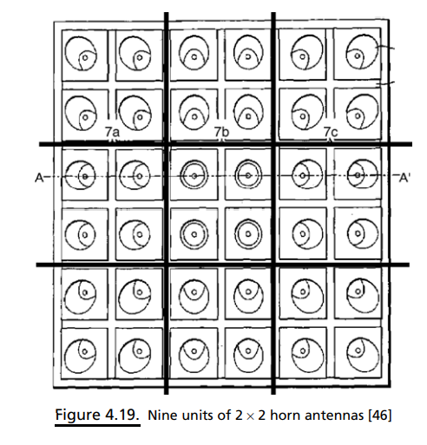
2x2 Beam Steering Antenna
The complexity of phase arrays at 60 GHz typically limits the number of elements.
In Figure 4.19, each unit, consisting of a 2x2 element array, acts as an independent source
This design requires a multi-bit phase shifter and generates good circular polarization.
By adding several tilted horns, this design can attain +-100◦coverage.
The feeding network needs to have the correct amplitude and phase in the two orthogonal linear polarizations in order to generate good circular polarization.
The main challenge in this design is reducing the sidelobe level caused by the 2 X2 elements.

Slide 26
